Slide 1
Broughton Allotments
From Chaos to Cultivation
A seven year journey of transformation

Slide 2
History
Two allotment sites (Nook & Coldgill) were transferred from Cumbria County Council to Broughton Parish Council in 2007
The two sites (divided into at that point circa 80 plots)
A basic lease was inherited with the transfer (this had been the same since in some cases 1981!)
There were no ‘good practice’ Policies and Procedures in place
No annual budgeting process appeared to have been undertake
Some allotments were poorly managed with uncultivated/abandoned plots being left to remain for prolonged periods
Ultimately in 2016 when this process started the Allotments were unmanaged and a significant risk to the Parish Council (financially, legally, visually, reputationally)

Slide 3
Issues to be tackled:
(and this was a LONNNNGGG list!)
Budget- There needed to be one!
Pricing- Needed to be reviewed having not been reviewed since the late 90’s, considerations needed to include
    Administration Time
    Management Time
    Pest Control (Sadly allotments come hand in hand with pests and not all rats are cute like Remy from Ratatouille)
    Water Supply
    Maintenance of communal areas (including trees and tree surveying)
    Clearance of abandoned plots
    Management of external site boundaries
    Asbestos!
Policies- Some of these were needed too (as you never want to find out after the fact that someone is keeping pigs/dogs/horses/goats/llama’s on your plots!)

Slide 4
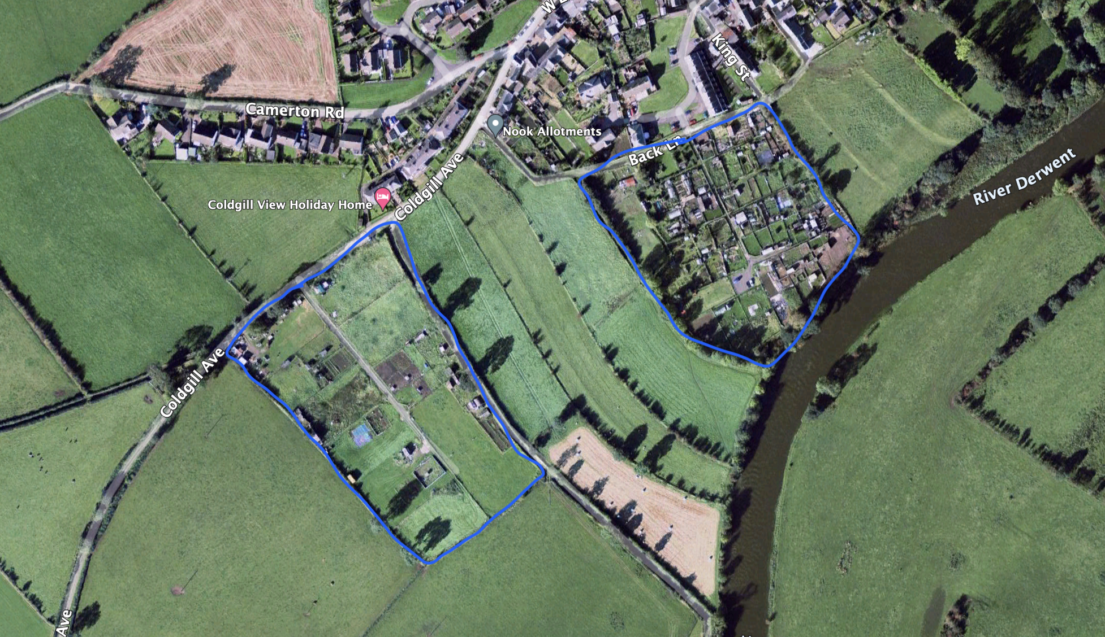
Before…..

Slide 5
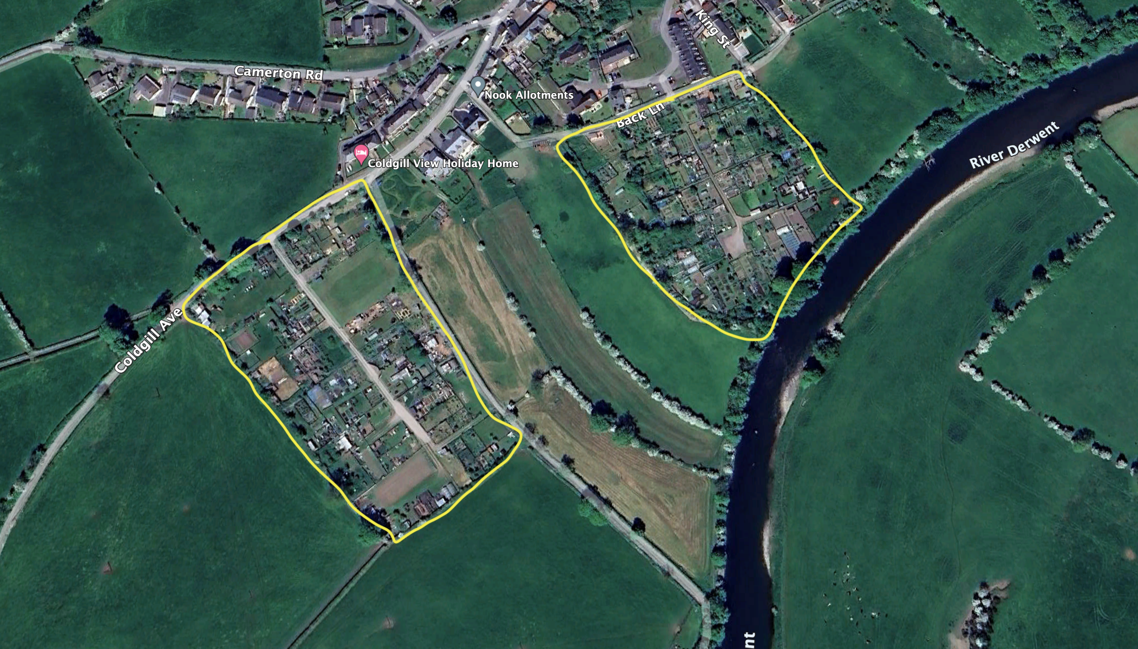
After!

Slide 6
Solutions to the challenges
To quote Nat Turner ‘Good communication is the bridge between confusion and clarity’
Allotments and allotment holders have a really strong sense of community and rumors/Chinese whispers can spread like wildfire.
Direct, clear and regular communication and engagement has been the key to what Broughton PC has managed to achieve.
Accurate, evidential reasons for action e.g. to alter the pricing we had each site and then each plot accurately measured, a budget was then produced based on the previous years actuals, budget / Sq M of allotment plots = Gave us a price per Sq M
A revised tenancy agreement was drafted and then consulted on with ALL tenants this met current good practice and was clear and transparent
Visible presence and consistency. Broughton Parish Council has been lucky to have amazing Councilors who have month in and month out done walk arounds to check on plots, clear actions followed each work around

Slide 7
Innovative low cost support options
Broughton Parish Council have recognized for many years the physical, mental and social benefits of allotments and wanted to continue to promote these, but budget was limited, we therefore introduced a number of low cost solutions to try and improve plot management:
    Buddying system- New and aspiring allotment holders were buddied up with experienced plot holders who could provide help/support on all things horticultural
    Start Plots– The first large plot that we had returned to the Council after we started this revitalization process was subdivided into a number of very small plots, these have been used very successfully as starter plots where new tenants have been able to have a plot of their own that remained manageable
    Noticeboards/newsletters- We have started utilizing an ‘e-newsletter’ where we share season specific/relevant information to plot holders to encourage action where it is required (most recently this has been particularly valuable during the bird flu restrictions in the Winter of 2022)
    Annual Plot Holder meeting- This open forum meeting is held annually where common concerns/issues are discussed in public

Slide 8
Where are we now
(Note I didn’t say end result!)
Of 106 plots 104 are actively tenanted (the remaining two are plots with issues we are working to resolve)
The budget over the last 6 years has moved from being a loss making budget (resulting in the Parish Council having to subsidize the allotments year on year) to being nearly a break even budget (22/23)
Subject to any legislative or significant economic surprises the sites will be cost neutral from 24/25
A small capital reserve pot will start to be accrued from 24/25 this will be kept at a low level but will allow for un-budgeted costs to be met by the allotments e.g. asbestos clearance, water system repairs etc.
Fundamentally the allotments are a work in progress and will likely remain so, but from where we started to where we are now, they are I am delighted to say, unrecognizable!

Slide 9
Mary Bradley (Broughton Parish Council Chair) marybradley52@btinternet.com
Becx Carter (Broughton Parish Council Clerk & RFO) broughtonparishclerk@Hotmail.com

